Slide 1
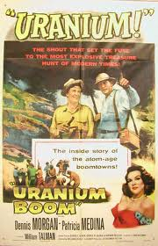
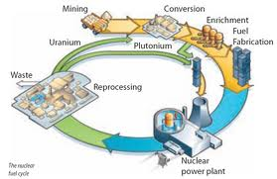
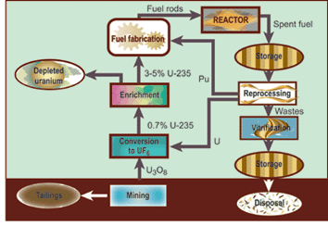
The Nuclear Fuel Cycle

Slide 2
What is a Fuel Cycle?
The name might sound dull and unimportant to those interested in policy. One obtains a fuel, processes it to get it into a suitable form, uses it to make energy. Where’s the policy relevance?
… but wait. This diagram is missing something, something that will be critically important in our discussions. What is it?

Slide 3
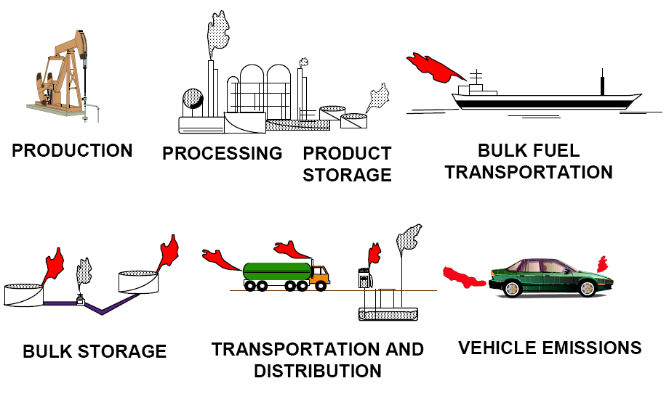
Why Study Fuel Cycles?
This diagram shows all the points at which waste products are produced (little red and grey puffs of smoke).
Not to give the petroleum people a hard time – though that’s always fun – but rather because reducing the consumption resources and the production of waste, per unit of energy sold, is the central objective of studying fuel cycles.
Oh, and of course these objectives must be achieved while remaining cost-competitive!

Slide 4
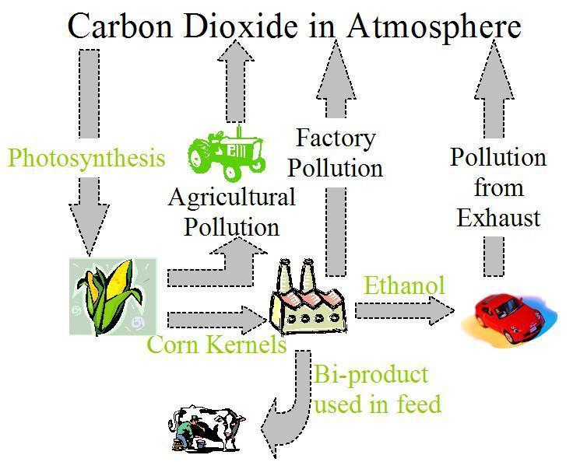
Alternative Fuel Cycles
Of course, the petroleum cycle is not the only choice for automobiles. The cartoon below depicts the corn-ethanol fuel cycle.
There is an ongoing debate: does the corn-ethanol fuel cycle reduce or increase greenhouse gas emissions?

Slide 5
Fuel Cycle Waste Products
The two figures below illustrate the differing viewpoints on the subject.
Source: T. Patzek, UC-Berkeley, “Thermodynamics of the Corn-Ethanol Biofuel Cycle”
Source: Dept. of Energy, National Renewable Energy Laboratory Brochure
The figure at left implies that ethanol produces zero net CO₂ since the emissions are recycled by plants. The figure at right argues that the emissions from ethanol are in fact higher than those from gasoline because CO₂ is produced both from the plant matter and chemical processing. Both are correct in a sense.

Slide 6
Similarities and Differences
Nuclear fuel cycles are similar to the automobile fuel cycles in that:
Different types of nuclear fuel produce different “emissions”
Reactors might have to be redesigned in order to be able to burn a new type of fuel
Certain types of fuel can do a better job at conserving natural resources than the type we’re using now
Fuel cycles that conserve natural resources and reduce waste are, alas, more expensive to operate than the one we’re using now.
Nuclear fuel cycles differ from the automobile fuel cycle in that:
Nuclear wastes are solid or liquid and can (in fact, must) be contained and stored until they’re harmless, as opposed to automobile wastes that are gaseous and very difficult to capture
Automobile wastes persist for centuries to millennia; nuclear wastes become harmless only after tens of millennia.

Slide 7
Nuclear Fuel “Emissions:” by Mass
94% of spent fuel, by mass, is uranium.
About 5% is “fission products,” the large fragments into which uranium breaks when it splits.
The remainder is plutonium and the “minor actinides:” neptunium, americium, curium. These elements are all unstable, heavier than uranium, and formed as byproducts of the chain reaction.

Slide 8
“Emissions:” by Nastiness
6% of the mass accounts for 99%+ of the decay power.
The decay power 100 years after discharge from a reactor is a measure of how hard it is to design an “interim storage facility” to store spent fuel.

Slide 9
“Emissions:” by Long-Term Nastiness
1% of the mass accounts for 99%+ of the long term decay power and radiotoxicity.
The decay power 1,000 years after discharge from a reactor and the radiotoxicity 10,000 years after discharge are measures of how hard it is to design a “permanent repository” for nuclear waste.

Slide 10

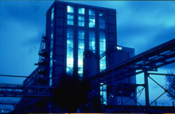
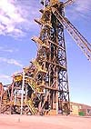
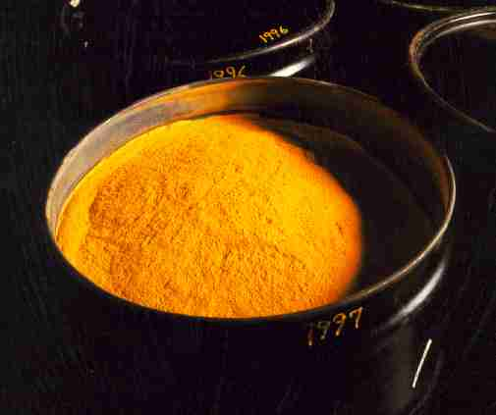
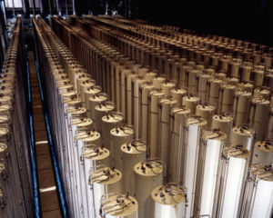

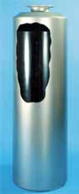
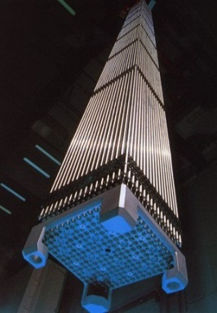
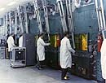
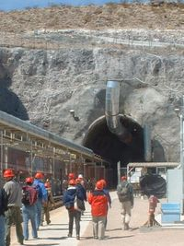
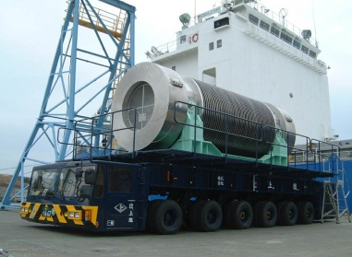
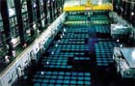
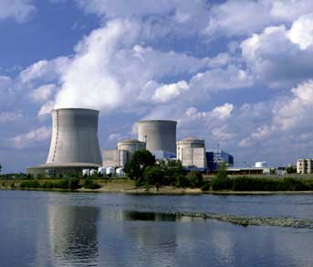
Graphic of Nuclear Fuel Cycle
Uranium Mining,
Milling, Refining
Conversion
Enrichment
UF₆
(gas)
Depleted
Uranium
Yellowcake
(U₃O₈)
Ore Tailings
Enriched
UO₂
Vitrification
Pu and
(maybe)
other
actinides
High
Level
Waste
(HLW)
Fuel
Fabrication
Vitrified
HLW
Reprocessing
Fuel
Assemblies
Irradiated
Fuel
e⁻
Disposal
Onsite Cooling
Storage
Transportation
Reactor

Slide 11
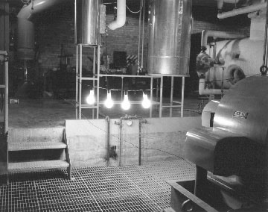
A Brief History of the Nuclear Fuel Cycle
1943-1945 | The nuclear fuel cycle is born in war: uranium mining and milling: Port Hope, ON enrichment, gaseous diffusion and calutron, Oak Ridge, TN plutonium production reactors: graphite moderated, water cooled: Hanford, WA reprocessing (bismuth phosphate process), Hanford, WA
1951 | First nuclear electricity produced by . EBR-I (Experimental Breeder Reactor 1) . in Idaho. It was widely expected at this . time that a closed fuel cycle centered . around breeders would quickly be . adopted. EBR-I did breed plutonium . (eventually achieving a breeding ratio of . 1.27) and, in 1963, demonstrated a breeding fuel cycle by going critical with fuel made from plutonium that had earlier been produced in the reactor.

Slide 12
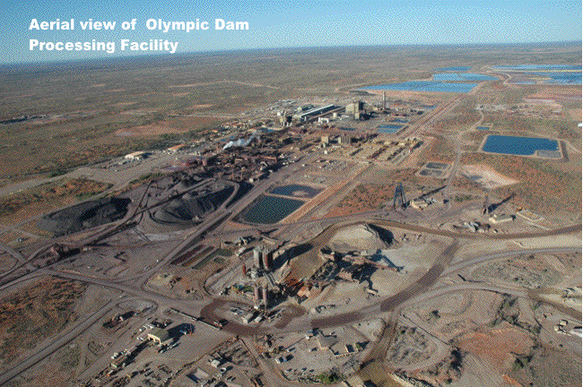
A Brief History of the Nuclear Fuel Cycle
1975 | The world’s largest uranium deposit (over 1 million . tons U₃O₈) is discovered at Olympic Dam in . Australia by prospectors searching for copper. The . uranium spot price, which exceeded $100/lb U₃O₈ . . in the late 1970s (constant 2004 dollars), falls to . $10/lb by 2000.
1977 | Shippingport is loaded with a thorium breeding blanket and produces U-233. This demonstration of the thorium fuel cycle is not repeated, nor is the U-233 re-used in a commercial power plant. Experimentation with thorium also occurred at Peach Bottom and Fort St. Vrain as well as facilities in Germany and the UK.
1977 | Pres. Carter signs an executive order banning the reprocessing of commercial SNF (spent nuclear fuel) in the United States. A large scale reprocessing plant under construction at Barnwell, SC was cancelled. Carter’s decision was based on nonproliferation concerns; it was expected that other countries would follow the US lead and move away from plutonium separation. This did not occur. The ban was lifted by Pres. Reagan in 1981 but the momentum toward reprocessing in the US, already flagging due to economic factors (e.g., steep decrease in the price of uranium), was broken.

Slide 13

A Brief History of the Nuclear Fuel Cycle
1987 | Commercial-scale use of MOX fuel begins in France with the loading of 16 MOX fuel assemblies in a reactor at Saint-Laurent-Les-Eaux. France’s reprocessing infrastructure continues to expand (La Hague reprocessing facility, MELOX MOX fabrication plant). 16 French reactors, all PWRs, currently burn MOX fuel.
1987 | Yucca Mountain is selected as the only site to . . be considered for the US spent fuel repository. . The site is composed of layers of tuff and is . situated 1000 ft above the local water table. . YM is to have a legislated capacity of 70,000 . MtIHM (metric tons initial heavy metal) of SNF. . It is (as of July, 2006) scheduled to begin accepting waste in 2017.
1992 | Finland commissions an underground repository for low and medium level waste at Olkiluto. Situated at a depth of 70-100 m in crystalline rock, the facility can store 8000 m³ of waste. Subsequently, Finland selected this site as the host for a deep repository for SNF. The repository is scheduled to begin operation around 2020.

Slide 14
Current (2005) Redbook Uranium Supply
The ‘Redbook’ is the compendium, assembled by the OECD Nuclear Energy Agency and the UN IAEA, to which countries report their uranium reserves.
Table. Uranium Resources [million metric tons]
 | RAR | EAR-I | EAR-II | SR
< $40 / kgU | 1.947 | 0.799 | 1.700 | 4.557
$40-80 /kgU | 0.696 | 0.362
$80-130 /kgU | 0.654 | 0.285 | 0.819
> $130 /kgU | -- | -- | -- | 2.979
TOTAL | 4.743 |  | 10.055
Redbook Total:
4.743 MMT (confirmed)
14.798 MMT (confirmed plus speculative)
Recoverable Phosphates:
~22 MMT
Current annual world consumption: 0.067 million metric tons
So we have ~70-220 years’ (confirmed-speculative) supply?

Slide 15
Crustal Abundance of Selected Elements
ELEMENT | ABUNDANCE (g/ton)
GOLD | 0.004
SILVER | 0.07
TUNGSTEN | 1.5
MOLYBDENUM | 1.5
URANIUM | 2.7
THORIUM | 7
LEAD | 13
COPPER | 55
ZINC | 70
IRON | 50,000
ALUMINUM | 81,300

Slide 16
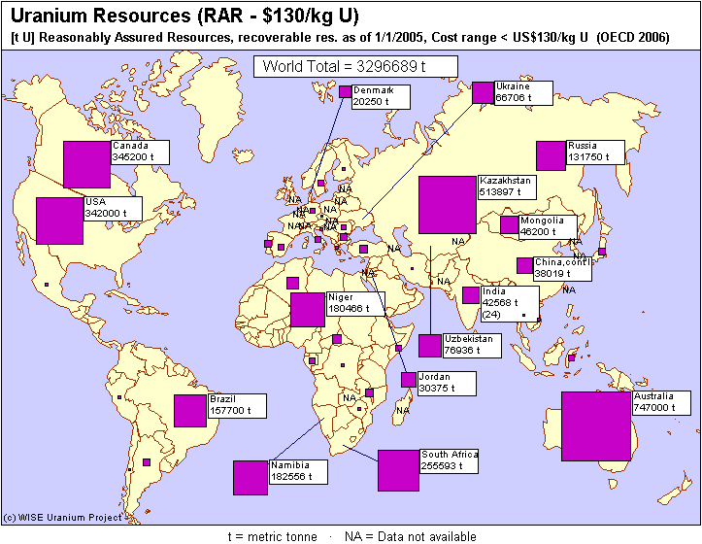
Where is the Stuff?
Context: Current Consumption rate is 67,000 t/yr.

Slide 17
The Role of Expectations
Until the early 1980s, explosive growth in uranium demand was forecast. In fact, demand was expected to outstrip the capacity of new mines to come online.

Slide 18
Other Factors Affecting the Market: Technological Change
Resource depletion tends to push prices up. Other factors act in the opposite direction. The most significant of these might be the advance of technology. As shown in this figure, the amount of uranium extracted by one miner working for one year increased sixfold (US and Canada) between 1980 and 1995.

Slide 19
Enrichment: Technologies
Presently Commercialized
Diffusion
Centrifuge
Other Processes
Separation Nozzle
Atomic Vapor Laser Isotope Separation (AVLIS)
Electromagnetic

Slide 20
Schematic of One Stage: Diffusion
A schematic diagram of a single gaseous diffusion stage is shown below.
It’s important to note that this process requires a great deal of electric power:
the feed and product stream pressures must be maintained
the heat of compression must be removed from the feed stream
the process flow rate must be maintained
All this pumping and cooling, combined with
the poor separation factor, makes diffusion
economically unattractive compared to
other processes.
To next
enrichment
stage
Heat
Exchanger
Compressor
60 C,
0.6 atm
From previous
enrichment
stage
Vacuum
Pump
Heat

Slide 21
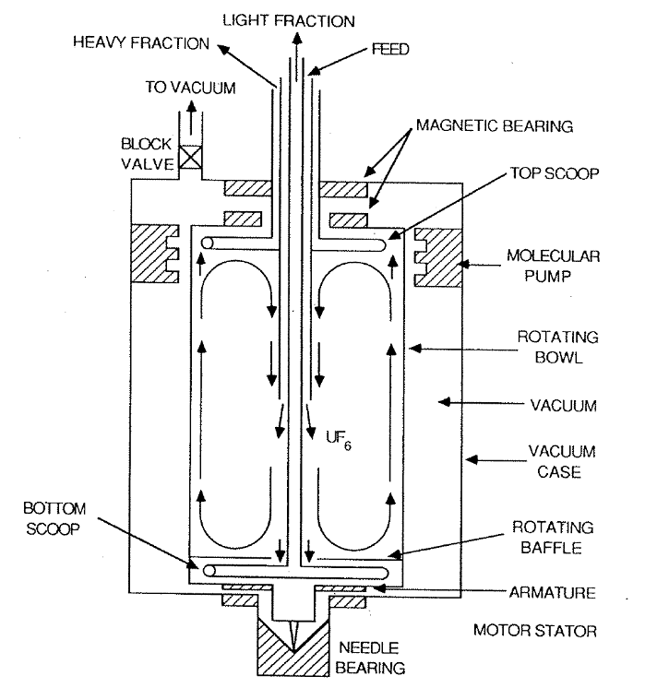
Centrifuge Enrichment – Physical Principles
Every time you spin a salad dryer, you see that, when subjected to rotation, heavier materials in a mixture will concentrate near the outer wall, outside of the lighter stuff.
The same principle is operative in a centrifuge. UF₆ gas is rotated at very high angular speeds, with the result that the heavier ²³⁸UF₆ is concentrated near the wall while the lighter ²³⁵UF₆ is relatively more prevalent near the center of the chamber.
ω

Slide 22

Thousands of Centrifuge Units, Connected in Series and Parallel, Form a Cascade
Product
N
N-1
( ……. )
i+2
i+1
Stage
Feed
i
i-1
( ……. )
2
1
Tails

Slide 23
The Process of Fuel Fabrication
This illustration shows the process for uranium oxide fuel. Mileage for other fuel types may vary.
(note: 1-2% of U may be lost in this process!)

Slide 24
Fuel Fabrication
The geometry of a fuel assembly must be very precise, as any distortions can affect neutronic performance and heat removal.
Not every element in a fuel assembly grid is occupied by a fuel rod. In some cases, channels may contain control rod guide tubes, or they may not be occupied at all.
The hands-on fuel fabrication process here is used for uranium oxide fuel. This process is relatively inexpensive and simple: it costs about $200 / kg U to fabricate UO₂ fuel.

Slide 25
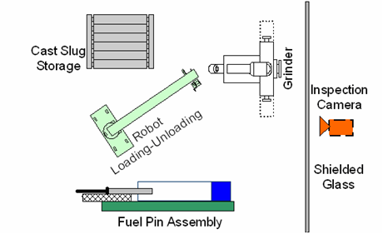
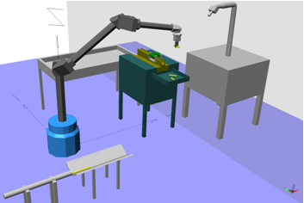
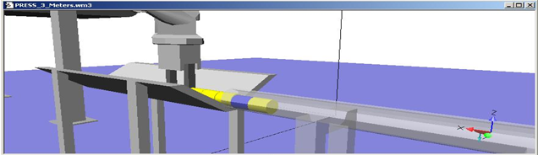
Remote Handling
In certain cases, for instance the fabrication of mixed oxide fuels, the material must be handled using a glove box.
Extremely radioactive fuels, such as those proposed for use in many transmutation schemes, must be fabricated entirely remotely. The robotic system shown here illustrates this process.
Glove box conditions can add a factor of ~3 to the cost. A fully remote process could be an order of magnitude more expensive.
Camera Inspection (top)
Placement in rod (right)

Slide 26
Fuel Assemblies
5 cm x 5 cm
(15x15 to 18x18 grid)
5x5 to 9x9 grid
4 m
BWR
Control
Rods
Grid
PWR

Slide 27
Reactor Types
Just as you can’t burn pure ethanol or hydrogen with today’s off the shelf automobiles, the more advanced nuclear fuels – especially those that recycle the plutonium and minor actinides that we saw caused such trouble in the waste – can’t be burned in today’s reactors.
Therefore, reactors affect and shape fuel cycles.
The following slides summarize advanced reactor types. This has already been covered, so we’ll pass through them quickly. They are ordered from designs we’ll see built in the near future to hypothetical concepts.

Slide 28
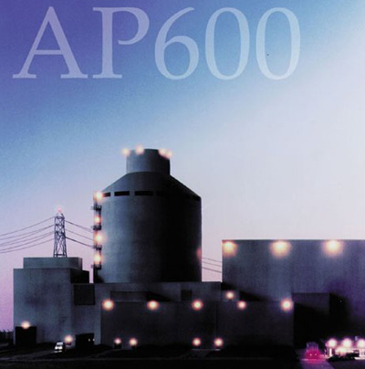
AP-600/AP-1000
Westinghouse design which just obtained Nuclear Regulatory Commission licensing
This is an ALWR, for which AP-600 = 600MWe and AP-1000 = 1,000 MWe. It’s very similar in concept to today’s pressurized water reactors.
Classified as GEN III reactor, which main features are:
Modularity/scalability
Simplicity
Passive safety features
Economic

Slide 29
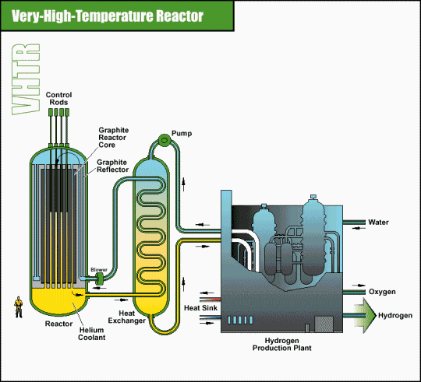
High Tempature Gas Cooled Reactors (HTGR)
HTGRs use gas, typically He, as a coolant.
Only reactor type to achive 900 degrees C.
Many process heat applications at this temperature
HTGRs can handle a wide range of fuel types without needing to be seriously redesigned or reconstructed.
Some Pebble-Bed Reactors are HTGRs
HTGRs have many passive saftey features
Durring the 1960s-80s several prototype HTGRs were built and operated for a total of 50 reactor-years
One of these test reactors was the German AVR which ran for 21 years and was shut down in the wake of Chernobyl.
A more modern buzzword for HTGR is “Very High Temperature Reactor” (VHTR)

Slide 30
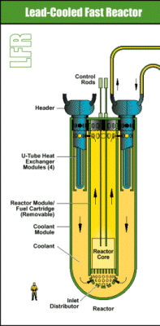
LFR: Lead-Cooled Fast Reactor
Fast-spectrum lead or lead/bismuth eutectic liquid metal-cooled reactor
Cooled by natural convection
Nuclear Battery option:
50-150 MWe with a very long refueling interval (15 – 30 yrs)
Attractive for remote locations and developing countries
Notes:
The LFR is one of the six Gen IV Nuclear energy system concepts being researched by 11 different countries.
The LFR has several power options with a range of plant ratings, including a battery of 50-150 MWe that features a very long refueling interval, a modular system rated at 300-400 MWe, and a large monolithic plant option at 1200 MWe. The nuclear battery is very attractive for deployment in remote locations (Alaska, Hawaii, Japan) and developing counties.
Another type of nuclear battery is the Toshiba 4S….(next slide)

Slide 31
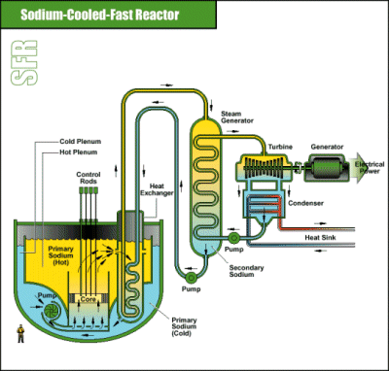
Sodium-Cooled Fast Reactor (SFR)
Sodium-cooled fast spectrum reactors using a closed fuel cycle with full actinide recycle

Slide 32
Molten Salt Reactor (MSR)
General Traits
originally one of the proposed
Gen IV thermal reactor concepts
fuel is dissolved in a molten fluoride salt which becomes critical when it flows into a graphite core region
salt is non-reactive with air or water and is operated at atmospheric pressures
meltdown proof….but not leakproof
compared to water cooled reactors the MSR allows higher operating temperatures (and efficiencies) and better cooling
can add actinides without extra fuel fabrication
primary loop corrosion and heat exchanger costs are major obstacles
Generation IV Reference Plant Layout

Slide 33
Spent Fuel Onsite Storage
Regardless of the ultimate reprocessing or disposal strategy, SNF is stored for a period of time to allow the shortest-lived species to decay.
This onsite storage period typically lasts for at least 5 years. Since the SNF produces so much heat during this time period, it’s usually stored in cooling ponds at the reactor site.
Hence this type of storage is referred to as onsite wet storage.

Slide 34
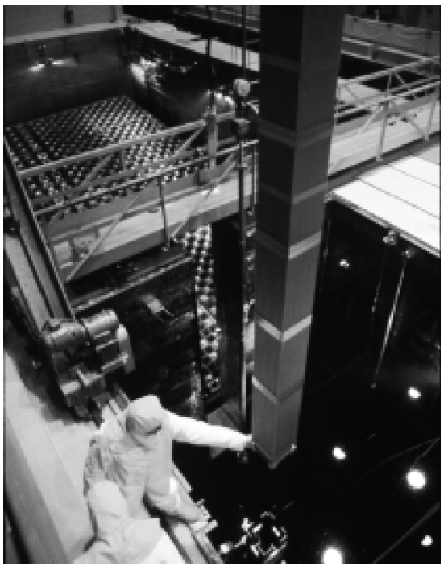
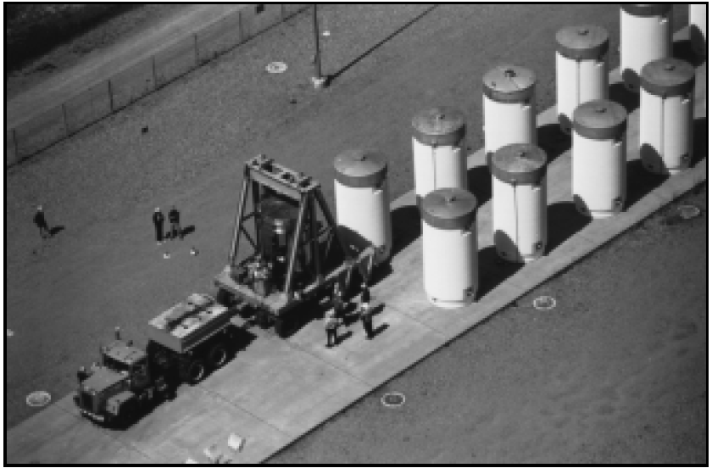
Storage
As of 2000, there were 150,000 tIHM of spent fuel in storage (more than 90% “wet” though not all of that is onsite).
70,000 tIHM of SNF had been reprocessed.
Wet storage is inexpensive and safe as long as:
recriticality is avoided (easy),
storage capacity (the size of the pool) is adequate (this is becoming problematic at many facilities).
Wet Storage
Dry (Cask) Storage

Slide 35
Reprocessing
Basic definition: the separation, by chemical or other means, of useful elements in spent nuclear fuel from others.
We distinguish between reprocessing and recycling: recycling is the re-use in a reactor of elements that were once contained in irradiated spent fuel.
Reprocessing does not always imply that all useful components will be recycled, although that is the usual motivation for reprocessing to occur.
The series of chemical processes that are utilized depends on the desired product – simple diagrams follow.
We distinguish between aqueous (in which fuel components are dissolved in water solutions) and non-aqueous processes.

Slide 36
Reprocessing – What is Separated?
LEGEND
Products,
Generally:
SNF
Feed
Pu
Recycled
SNF
PUREX
Pu
U
U
Stored
PUREX
Process
FP, MA
FP, MA
Disposed
SNF
UREX
TRU
UREX+2
Pu,Np,Am
SNF
U
U
FP
FP
Cm
SNF
TRUEX
Pu
SNF
COEX
Pu,1% of U
U
99% of U
Am, Cm
FP, Np
FP, MA
UNEX
MA
SNF
UREX+
Pu,Np
FP, MA
Cs,Sr
U
FP
Am, Cm
Rest of FP

Slide 37
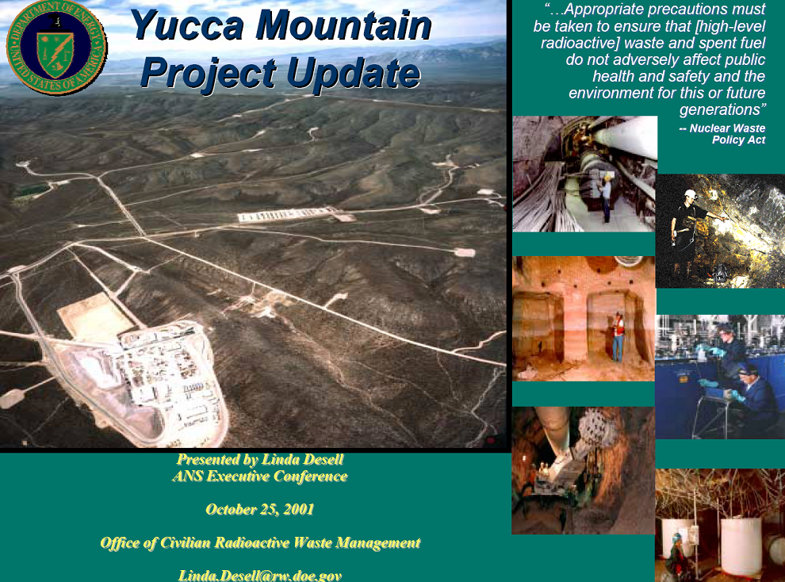

Slide 38
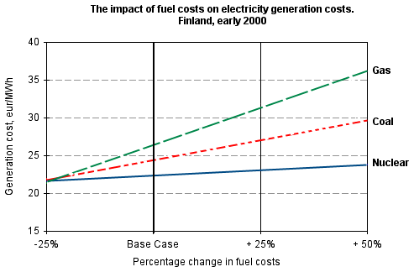
Sensitivity to Fuel Price
It’s well known that the cost of nuclear electricity is not strongly dependent on the cost of uranium. The figure below, which I found on the Uranium Institute website, shows this clearly:
If fuel (coal, natural gas, uranium) costs were to increase by 50%, the cost of generating nuclear electricity would increase by only ~2% whereas the cost of gas-generated electricity would increase by ~35%.

